Slide 1
user input in python
To accept user input in python, you need to use the input() function.
With the input() function, you can read from the keyboard input.
str = input("Enter your input: ");

Slide 2
Indentation in Python
Python indentation is a way of telling a Python interpreter that the group of statements belongs to a particular block of code. A block is a combination of all these statements. Block can be regarded as the grouping of statements for a specific purpose.
Most of the programming languages like C, C++, Java use braces { } to define a block of code. Python uses indentation to highlight the blocks of code. Whitespace is used for indentation in Python.
All statements with the same distance to the right belong to the same block of code. If a block has to be more deeply nested, it is simply indented further to the right.

Slide 3
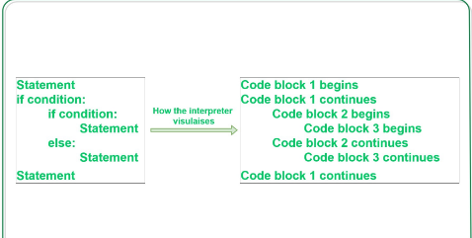

Slide 4
Decision Making
Decision making is required when we want to execute a code only if a certain condition is satisfied.

Slide 5
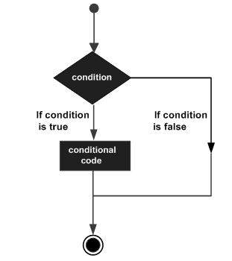
if Statement
The if…elif…else statement is used in Python for decision making.
A condition can be any logical expression returning only one of these two Boolean values: either True or False
if <condition>:
any task

Slide 6
Python if...else Statement
if <condition>:
Body of if
else:
Body of else
The if..else statement evaluates test expression and will execute the body of if only when the test condition is True.
If the condition is False, the body of else is executed. Indentation is used to separate the blocks.
the colon in the Python programming language’s syntax, is to give a visual indicator that a code block is following directly afterward.

Slide 7
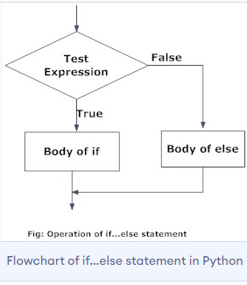

Slide 8
Python if...elif...else Statement
if test expression:
Body of if
elif test expression:
Body of elif
else:
Body of else
The elif is short for else if. It allows us to check for multiple expressions. If the condition for if is False, it checks the condition of the next elif block and so on.
If all the conditions are False, the body of else is executed.
Only one block among the several if...elif...else blocks is executed according to the condition.
The if block can have only one else block. But it can have multiple elif blocks.

Slide 9
